Slide 1
STAT 221-FUNDAMENTALS OF STATISTICAL DATA ANALYSIS
Week-5: Measures of Central Tendency, Dispersion and Distributions
Shivakumar Jolad
Associate Professor, FLAME University, Pune

Slide 2
Measures of central tendency

Slide 3
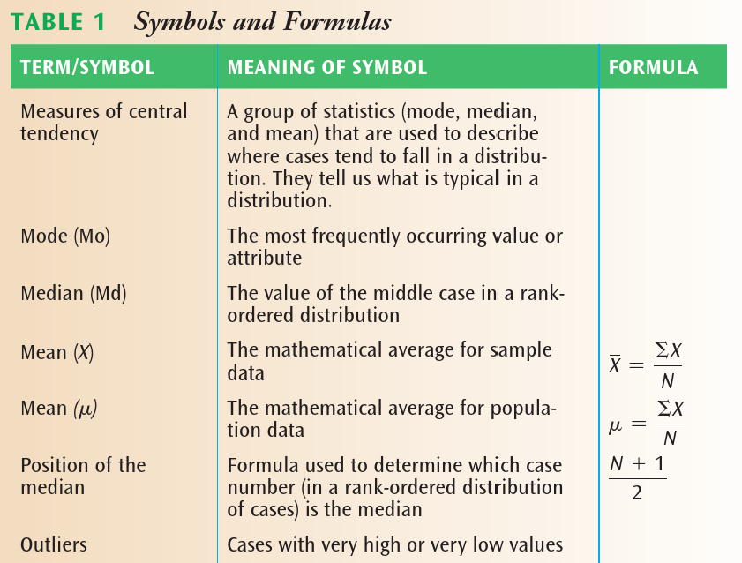
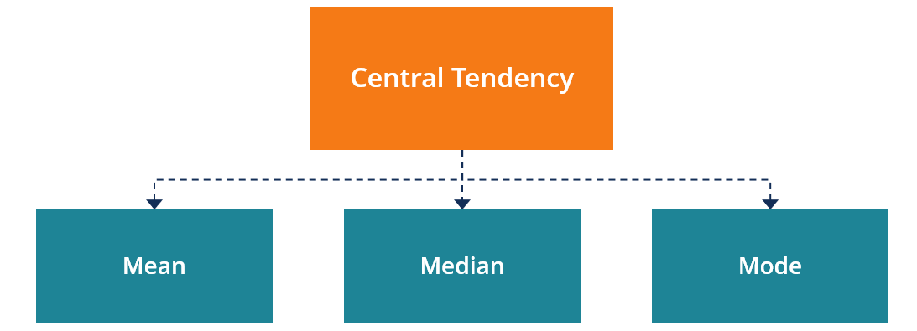
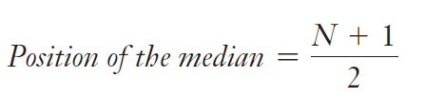

Measures of central tendency
Median The value of the middle case in a rank-ordered distribution.
$$Mean=\frac{∑X_{i}}{N}$$

Slide 4
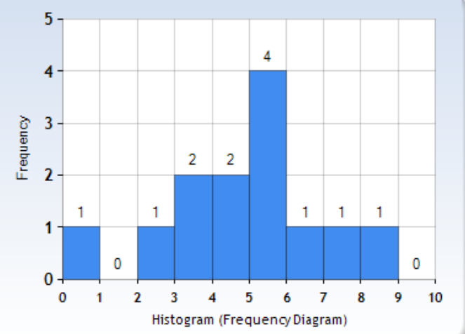
Mean, median, mode of individual data
RIDER # | # BUS TRIPS
1 | 5
2 | 3
3 | 10
4 | 5
5 | 8
6 | 6
7 | 5
8 | 4
9 | 0
10 | 2
11 | 14
12 | 5
13 | 7
14 | 4
15 | 3
N=15 | 81
 | # BUS TRIPS | Cases no
 | 0 | 1
 | 2 | 2
 | 3 | 3
 | 3 | 4
 | 4 | 5
 | 4 | 6
 | 5 | 7
 | 5 | 8
 | 5 | 9
 | 5 | 10
 | 6 | 11
 | 7 | 12
 | 8 | 13
 | 10 | 14
 | 14 | 15
Median | (N+1)/2 | 8
Median no of rides |  | 5
No of rides | FREQUENCY (no of people) | PERCENT | CUMULATIVE PERCENT
0 | 1 | 6.7 | 6.7
2 | 1 | 6.7 | 13.3
3 | 2 | 13.3 | 26.7
4 | 2 | 13.3 | 40.0
5 | 4 | 26.7 | 66.7
6 | 1 | 6.7 | 73.3
7 | 1 | 6.7 | 80.0
8 | 1 | 6.7 | 86.7
10 | 1 | 6.7 | 93.3
14 | 1 | 6.7 | 100.0
Total | 15 | 100.0
Mode=?
Median=?
Mean=?
Notes:
Mean 5.4
Mode 5
Median 5

Slide 5
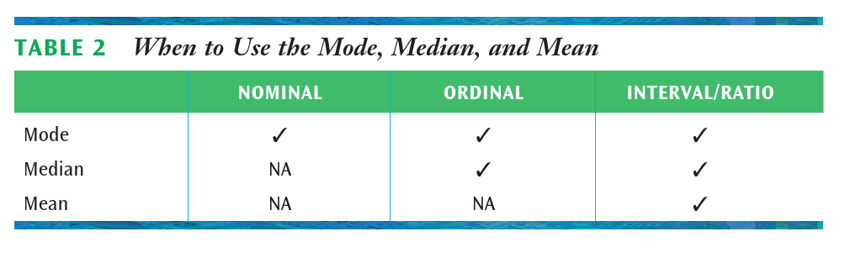
When to use mean, median, and mode
How much do you like mess food? | Frequency
Not all | 15
Somewhat | 23
Very much | 12
Total | 50
Religious affiliation | Frequency | Percentage
Hindu | 86 | 57.33
Muslim | 22 | 14.67
Sikhs | 12 | 8.00
Jain | 11 | 7.33
Christian | 6 | 4.00
Atheist | 10 | 6.67
Others | 3 | 2.00
Total | 150 | 100.00
Mode=?
Median=?
Mean=?
Mode=?
Median=?
Mean=?
Notes:
Religious affiliation:
Mode=“Hindu”
Median=?
Mean=?

Slide 6
Ordinal variables
Mothers education level (attended) | Frequency | Cumulative Frequency
No schooling | 4 | 4
Primary (1-5) | 12 | 16
Upper Primary(6-8) | 15 | 31
Secondary (9-10) | 26 | 57
Higher secondary/Diploma/Vocational | 20 | 77
College | 14 | 91
Post Graduate (PG and above) | 9 | 100
Total | 100
Mothers education level (attended) | Frequency
No schooling | 4
Primary (1-5) | 12
Upper Primary(6-8) | 15
Secondary (9-10) | 26
Higher secondary/Diploma/Vocational | 20
College | 14
Post Graduate (PG and above) | 9
Total | 100
Mode=
Median=
Mean=?

Slide 7
Interval/Ratio- GROUPED DATA
Highest year of school completed | FREQUENCY | PERCENT | VALID PERCENT | CUMULATIVE PERCENT
0 | 22 | 0.5 | 0.5 | 0.5
1 | 4 | 0.1 | 0.1 | 0.6
2 | 28 | 0.6 | 0.6 | 1.2
3 | 13 | 0.3 | 0.3 | 1.5
4 | 11 | 0.2 | 0.2 | 1.7
5 | 23 | 0.5 | 0.5 | 2.2
6 | 69 | 1.5 | 1.5 | 3.8
7 | 32 | 0.7 | 0.7 | 4.5
8 | 85 | 1.9 | 1.9 | 6.4
9 | 127 | 2.8 | 2.8 | 9.2
10 | 152 | 3.4 | 3.4 | 12.6
11 | 215 | 4.8 | 4.8 | 17.4
12 | 1204 | 26.7 | 26.8 | 44.1
13 | 422 | 9.4 | 9.4 | 53.5
14 | 628 | 13.9 | 14.0 | 67.5
15 | 212 | 4.7 | 4.7 | 72.2
16 | 687 | 15.2 | 15.3 | 87.4
17 | 167 | 3.7 | 3.7 | 91.2
18 | 208 | 4.6 | 4.6 | 95.8
19 | 78 | 1.7 | 1.7 | 97.5
20 | 112 | 2.5 | 2.5 | 100.0
Total | 4499 | 99.8 | 100.0

Slide 8
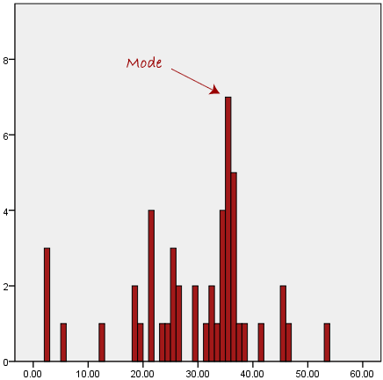
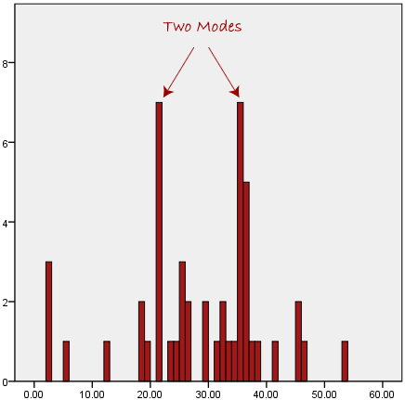
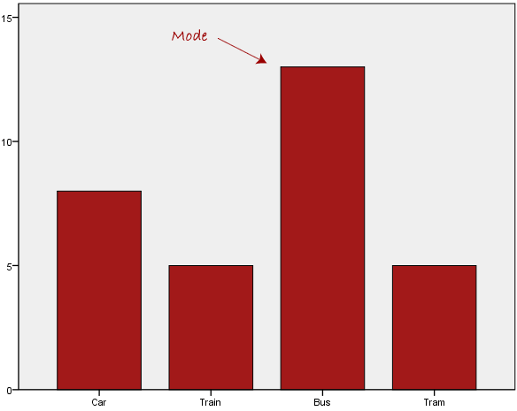
mode
https://statistics.laerd.com/statistical-guides/measures-central-tendency-mean-mode-median.php

Slide 9
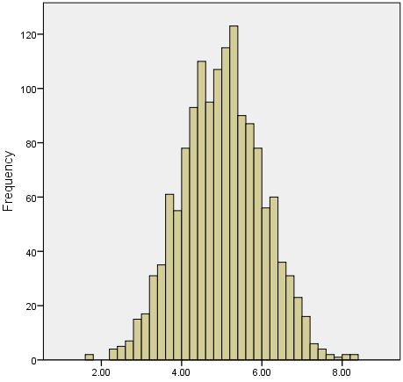
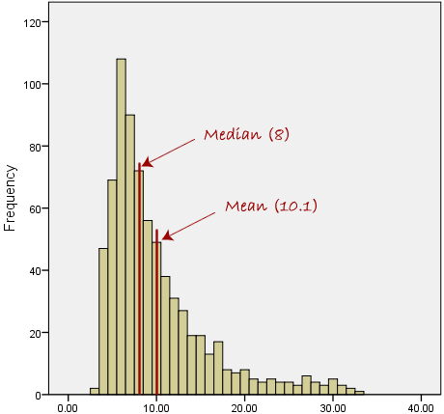
Skewed Distributions and the Mean and Median
https://statistics.laerd.com/statistical-guides/measures-central-tendency-mean-mode-median.php

Slide 10
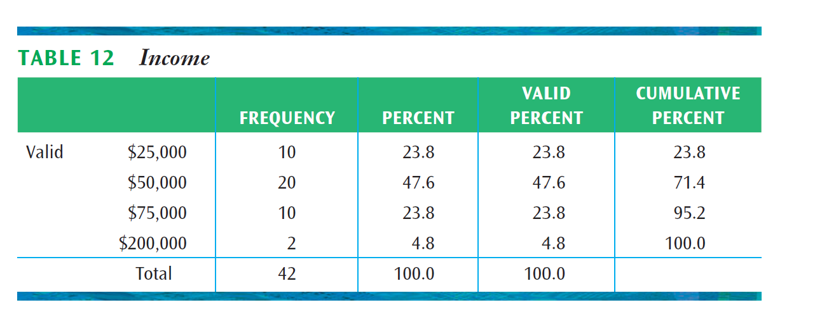
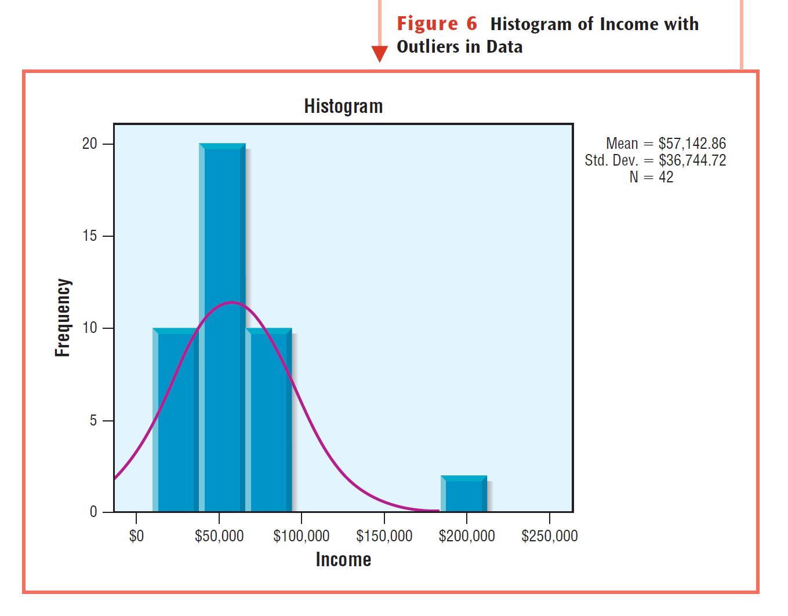

Slide 11
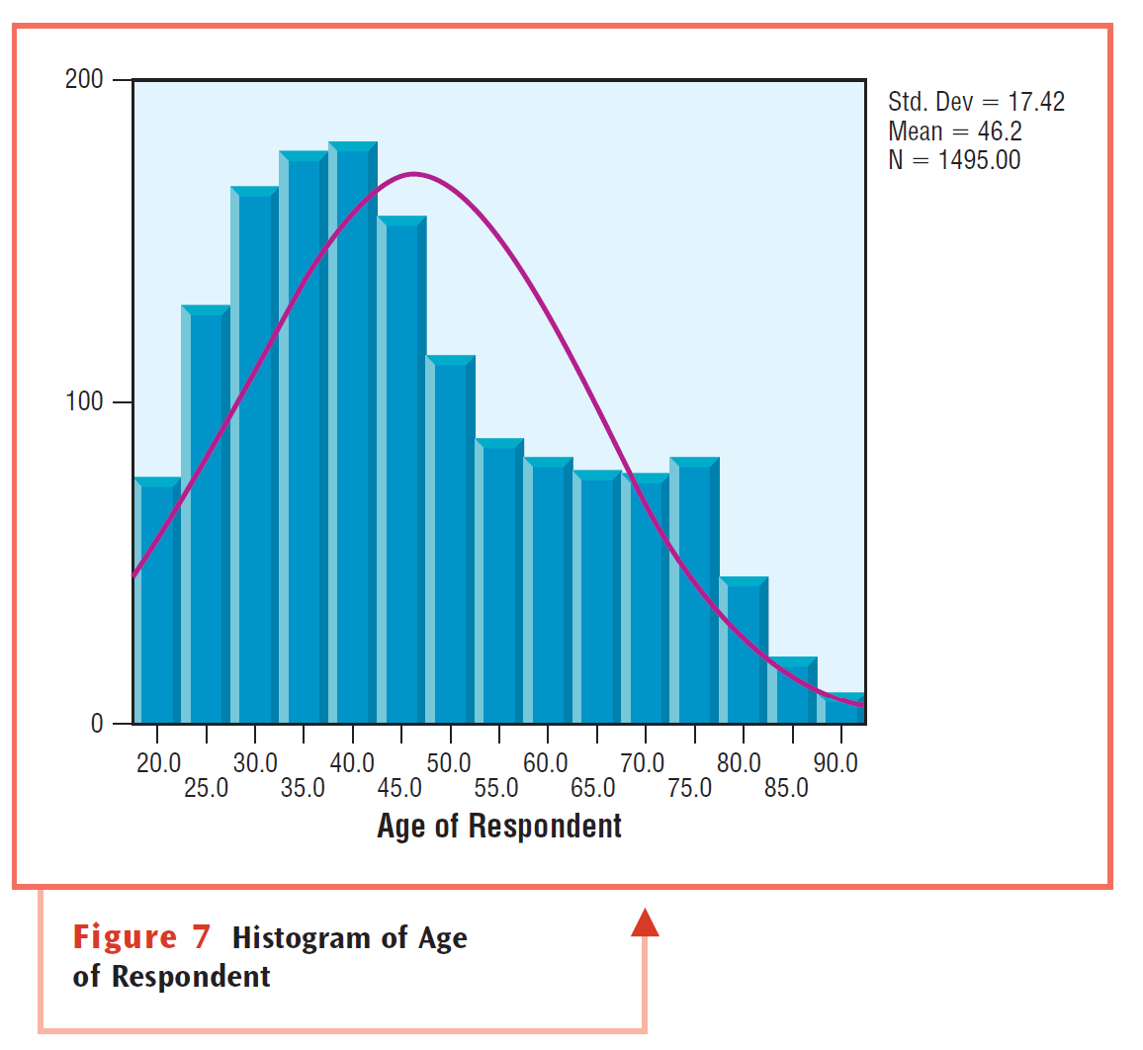

Slide 12
exercise
No of books read last one year | Frequency | Cumulative Frequency | Percentile
None | 7
1-2 books | 10
3-5 books | 11
6-10 books | 8
11 or more books | 8
Total | 44
Mode | ?
Median | ?
No of brothers/sisters | Frequency | Percent | Cumulative percent | Siblings-x-frequency
0 | 4
1 | 15
2 | 11
3 | 8
4 | 6
5 | 6
Total | 50
 | Median
 | Mode
 | Mean

Slide 13
Height Interval (cm) | Frequency | Cumulative frequency | Percentile |  | Height-middle | Height times frequency
[117-122) | 1
[122-127) | 3
[127-133) | 9
[133-138) | 25
[138-143) | 60
[143-148) | 130
[148-153) | 250
[153-158) | 434
[158-163) | 675
[163-168) | 938
[168-173) | 1169
[173-178) | 1350
[178-183) | 1420
[183-188) | 1169
[188-194) | 838
[194-199) | 675
[199-204) | 376
[204-209) | 250
[209-214) | 130
[214-219) | 60
[219-224) | 25
[224-229) | 9
[229-234) | 3
[234-239) | 1
Total | 10000
 |  |  |  |  | SUM | ?
Median Height | ? |  |  |  | MEAN | ?
Mode | ?

Slide 15
Factfulness control dramatic instincts in numbers

Slide 16
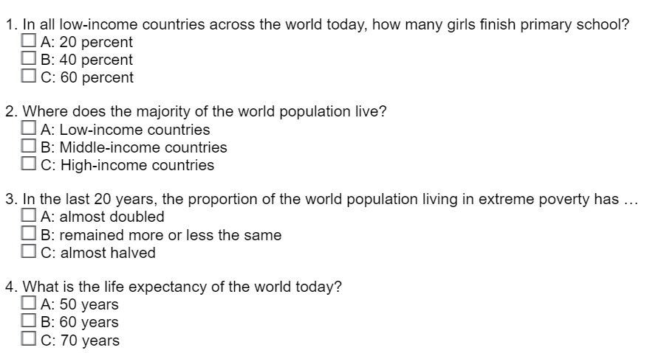
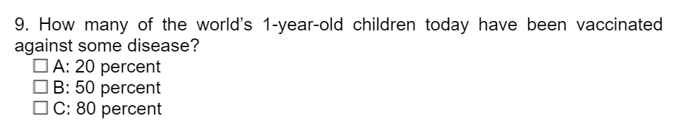
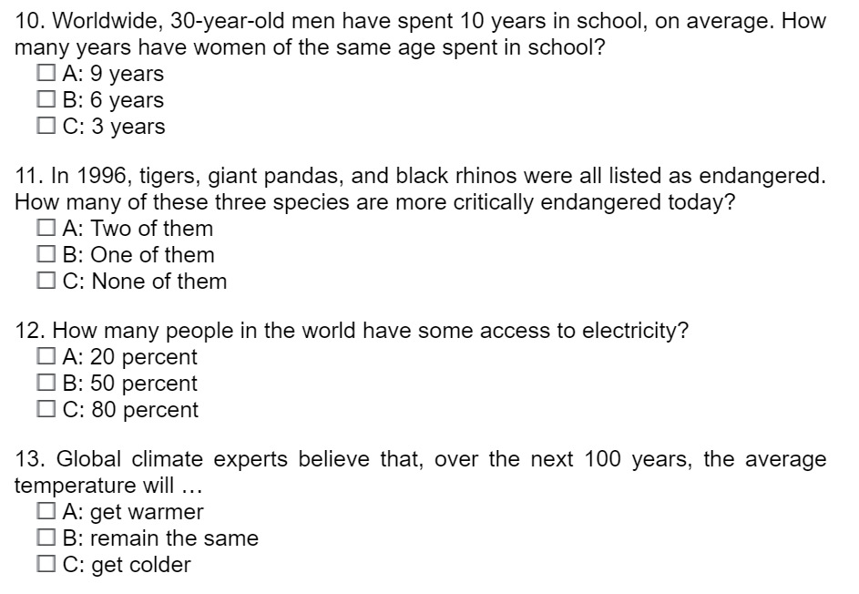
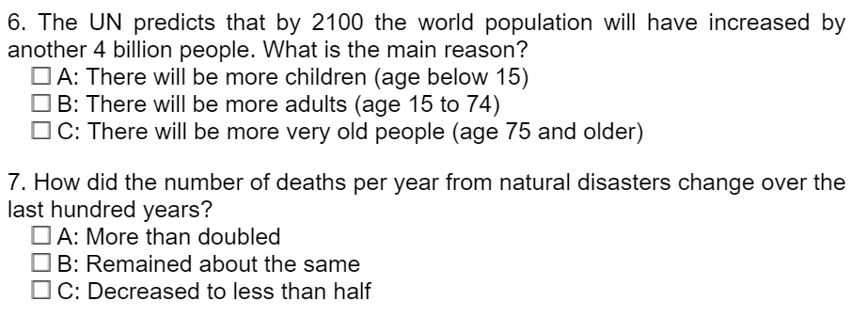
Class questions
Notes:
1: C, 2: B, 3: C, 4: C, 5: C, 6: B, 7: C, 8: A, 9: C, 10: A, 11: C, 12: C, 13: A

